Slide 1
ThunderBit
Rex Ferrer, Amanda Guinyard, Meena Rahimi

Slide 2
Vision
In today's society, staying fit and healthy is a must, but sometimes life may get in the way and it can be hard to stay healthy. You may need a device to keep it all together, in comes ThunderBit. This is an activity tracker that can be a force to motivate and remind its user to stay fit and healthy. Their goals can be set and met at the click of a button. The vision of this project is to implement an aesthetically pleasing personal health monitor that controls and monitors the users physical activities. Because this device can be used as a watch that displays the date and the time, users will be more inclined to use the other features just by swiping through the different screens. They will be able to see a summary of how long they have slept for that day and their sleeping patterns throughout the duration of its wear. The user will be able to track their steps along with how many calories they burn.

Slide 3
Major Features
Time Display
Activity Tracking
Sleep Pattern Recognition
Data Transmission

Slide 4
Primary Actor
USE CASES

Slide 5
Use Case Section | Comment
Use Case Name | Change the time
Scope | ActivityTracker Software
Level | User Goal
Primary Actor | User
Stakeholders and Interests | User: Wants to display time. Tracker: Displays time.
Preconditions | User is identified and “wearing” the activity tracker.
Success Guarantee | Tracker saves inputted time.
Main Success Scenario | User will press the settings button. Tracker will display the settings window. User inputs correct time. Tracker saves time.
Extensions | At any time, User can leave the settings window.
Special Requirements | User interface with click capabilities.
Technology and Data Variations List | Time display determined by User input.
Frequency of Occurrence | Could be continuous
Open Issues | N/A

Slide 6
Use Case Section | Comment
Use Case Name | Display Data to User
Scope | Activity Tracker Software
Level | User Goal
Primary Actor | User
Stakeholders and Interests | User: Wants accurate time,steps, calories, sleep data displayed Tracker: Accurate time, steps, calories, sleep data displayed
Preconditions | Tracker must be on
Success Guarantee | User can see the data whether it’s on their wrist or not.
Main Success Scenario | User looks at Tracker. Tracker displays correct data.
Extensions | User looks at Tracker. A non-time screen is displayed. User swipes/navigates to specific display. Tracker displays correct data.
Special Requirements | N/A
Technology and Data Variations List | N/A
Frequency of Occurrence | Continuous
Miscellaneous | N/A

Slide 7
Use Case Section | Comment
Use Case Name | Input goal(steps or calories)
Scope | ActivityTracker Software
Level | User Goal
Primary Actor | User
Stakeholders and Interests | User: Wants to track progress of goals
Preconditions | User is identified and “wearing” the activity tracker.
Success Guarantee
Main Success Scenario | Move to Steps or Calories Screen Set new goal Progress shown
Extensions | Goal is modified: Lower goal Higher goal
Special Requirements | N/A
Technology and Data Variations List | N/A
Frequency of Occurrence | Unlimited
Open Issues | N/A

Slide 8
Use Case Section | Comment
Use Case Name | Input personal data
Scope | ActivityTracker Software
Level | User Goal
Primary Actor | User
Stakeholders and Interests | User: Wants to keep their information private and input important data Tracker: Uses data customized for User
Preconditions | User is identified and “wearing” the activity tracker.
Success Guarantee | Tracker allows User to input data, and then saves the data.
Main Success Scenario | User will input data. Tracker will save the data. Tracker will re-display correct data.
Extensions | At any time, user can exits the data input window.
Special Requirements | User interface with input capabilities.
Technology and Data Variations List | User data determined by User input.
Frequency of Occurrence | Unlimited
Open Issues | N/A

Slide 9
USE CASE MODEL

Slide 10
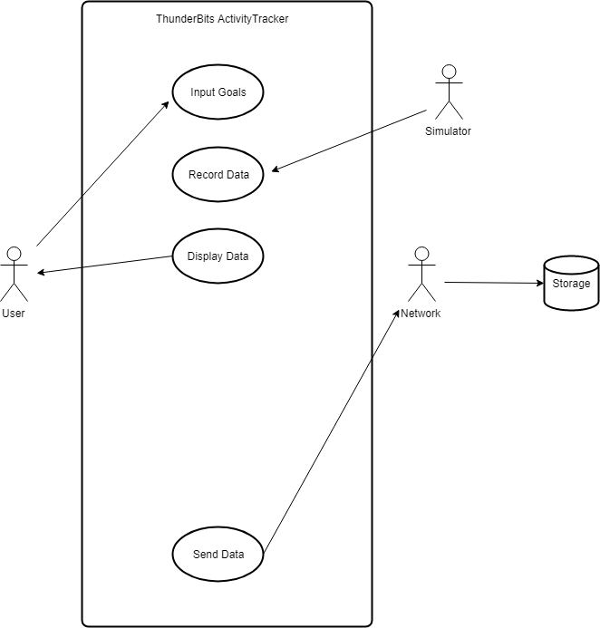

Slide 11
SYSTEM SEQUENCE DIAGRAMS

Slide 12
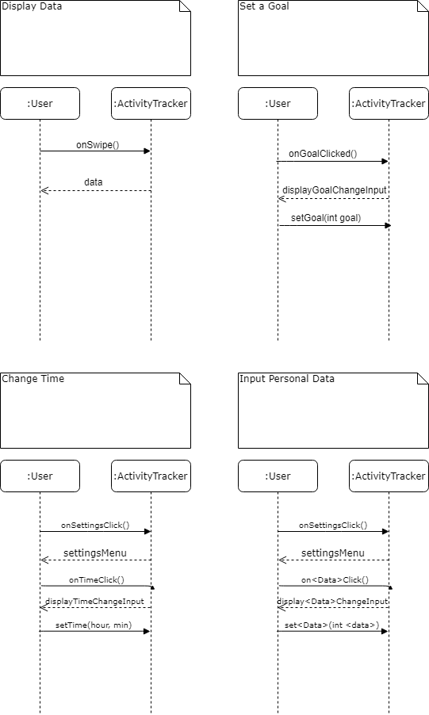

Slide 14
DOMAIN MODEL

Slide 15
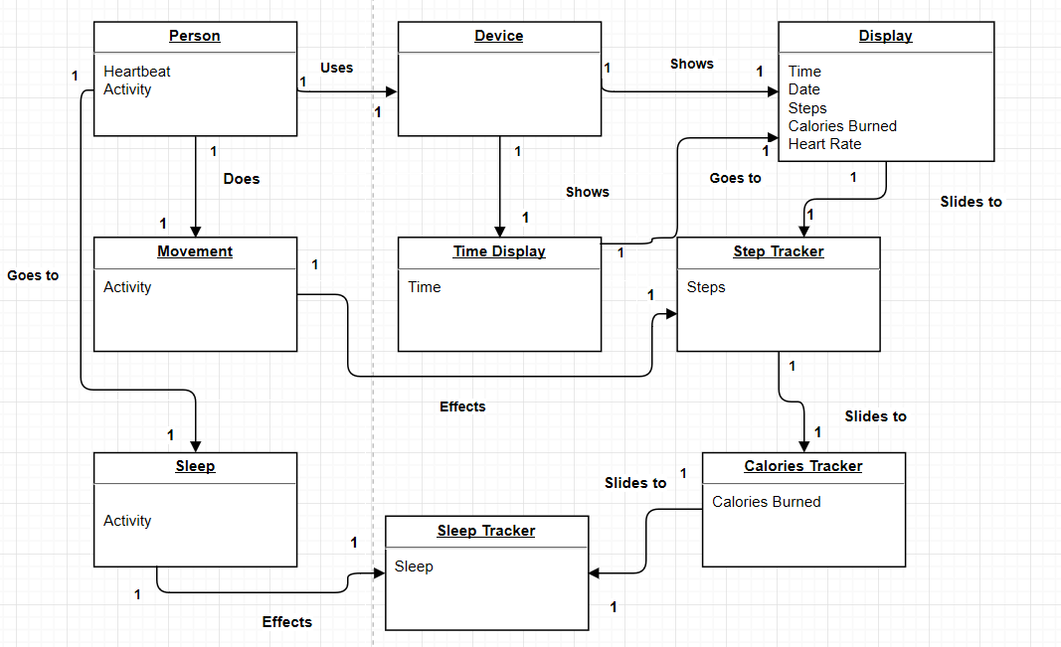

Slide 16
USER INTERFACE

Slide 17
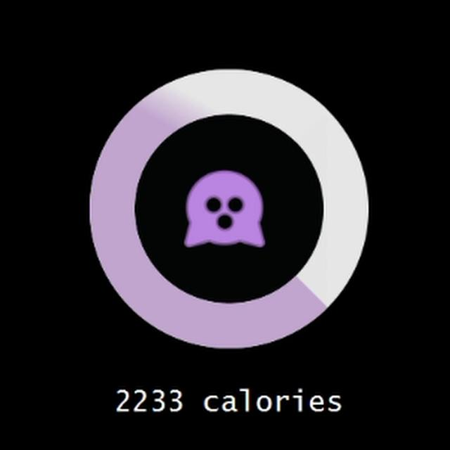

Slide 18
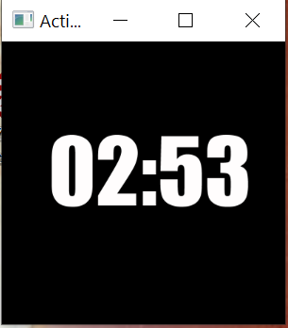

Slide 19


Slide 20
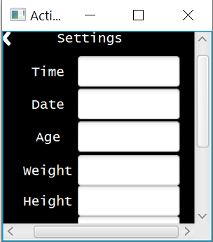

Slide 21
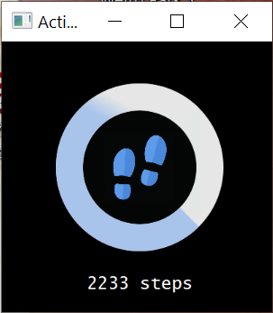

Slide 22
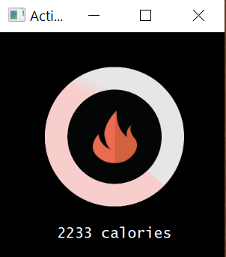

Slide 23
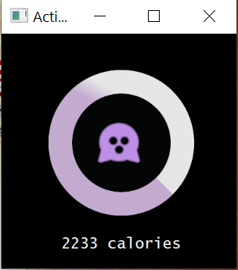

Slide 24
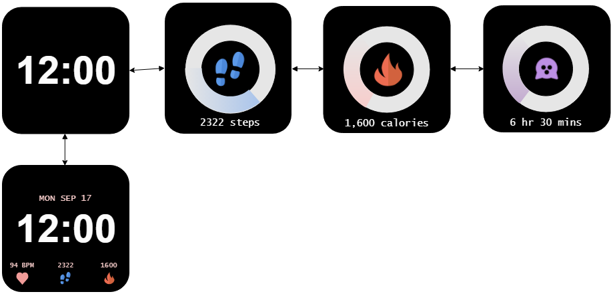

Slide 25
Additional and Future Progress
Classes: Steps, Calories, Sleep, HeartRate, various ViewControllers
Interfaces: HealthData
Future Classes: Settings, SettingsService, SettingsViewController, various Service classes for each View/Controller
Simulator: BodyState, RestingState + more interfaces + implementing classes, MovementState + implementing classes
Database Plans: Two identical DBs(Remote and Local Storage)

